Slide 1
Chongqing University of Technology
ATAI
Advanced Technique of Artificial Intelligence
Chongqing University of Technology
Attentive Pooling with Learnable Norms for Text Representation
(ACL-2020)
Reported by Ling Zhu

Slide 2
Chongqing University of Technology
ATAI
Advanced Technique of Artificial Intelligence
Chongqing University of Technology
1. Introduction
2. Innovation
3. Method
4. Experiments

Slide 3
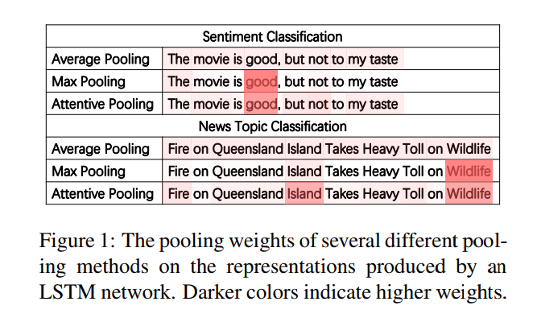
Introduction

Slide 4
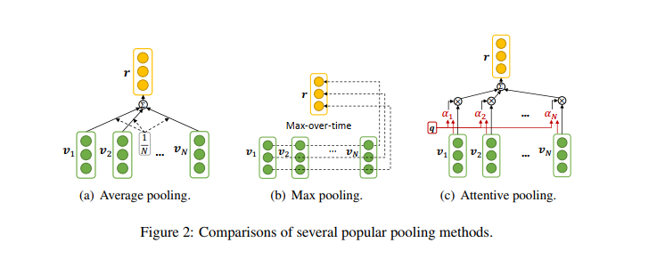
Introduction
Average pooling:
Max pooling:
Attentive pooling:
f(.) 是 tanh 函数,q 是 attention query vector

Slide 5
Introduction
Current issues:
1.average pooling equally regards the input representation vector at each position and ignores their different informativeness for learning text representation
2. these pooling methods use fixed average norms, i.e., $L^{1}$ norm for average and attentive pooling and $L^{∞}$ norm for max pooling, to build text representations, which may not be optimal when handling different tasks

Slide 6
Motivation
propose an Attentive Pooling with Learnable Norms (APLN) approach for text representation
propose two methods to ensure the numerical stability of the model training, the first one is scale limiting , the second one is re-formulation

Slide 7
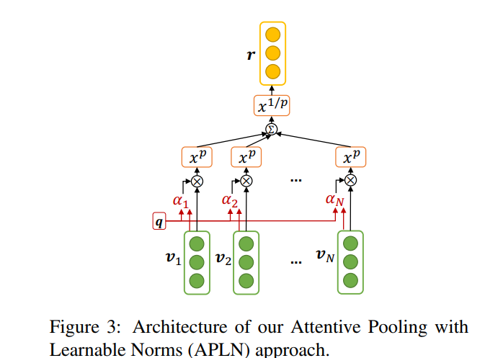
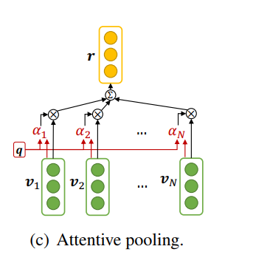
Approach

Slide 8
Approach
Scale Limiting:
Re-formulation:

Slide 9
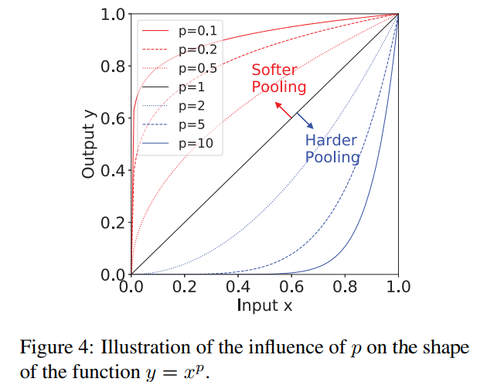
Experiments

Slide 10
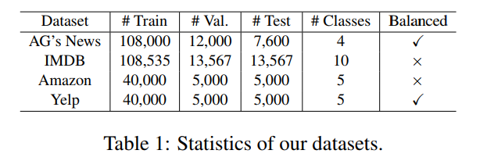
Experiments

Slide 11
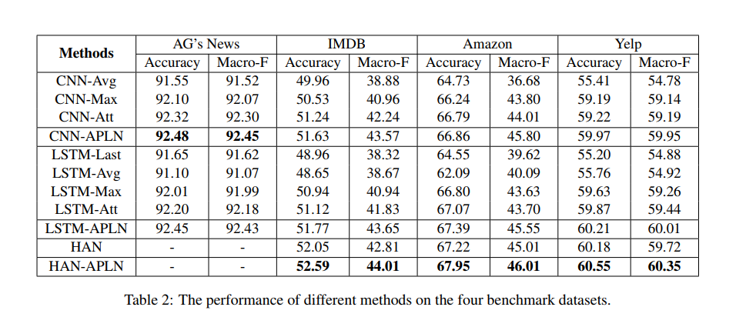
Experiments

Slide 12
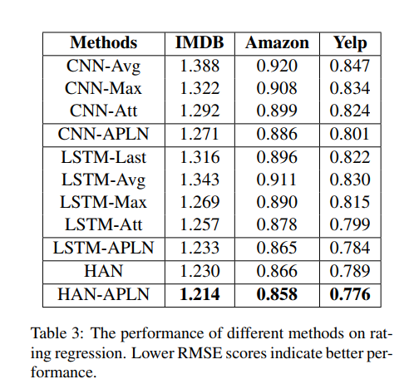
Experiments

Slide 13
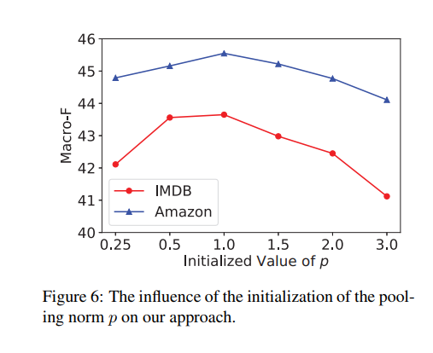
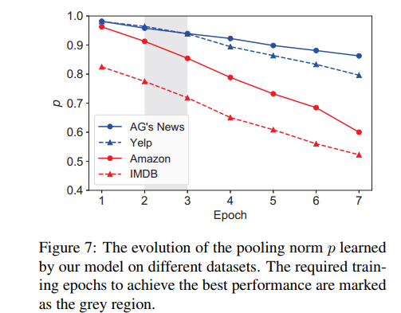
Experiments

Slide 14
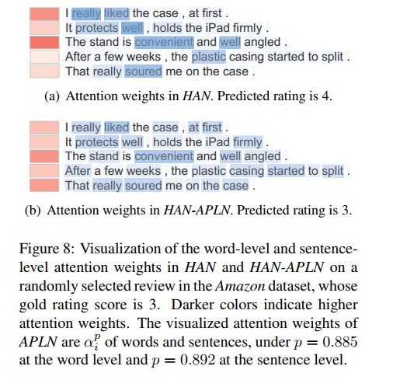
Experiments
Case study

Slide 15
Thanks

